Slide 1
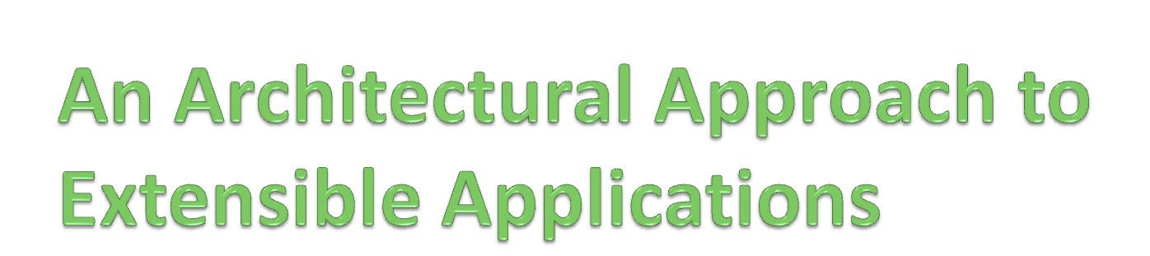
...or...
“towards making system evolution
as natural as creation”
Andrew McVeigh
Jeff Magee
Jeff Kramer
Imperial College, London
February 2011

Slide 2
An extensible application...
... allows functionality to be added, replaced or removed without requiring the source code of the application to be revealed or modified [KF98]
In other words
  It can be evolved by someone other than the creator
  We must support expansion and contraction [Par78]
  No guarantee of source code
Notes:
Ask how this differs from evolution - the two seem to get closer all the time... Particularly with the contraction idea.

Slide 3
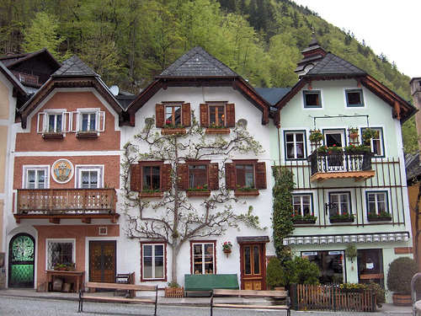
Why is extensibility important?
Allows others to customise an application
  Takes the burden off the system creators
  Allows niche requirements to be met
  Scalable ecosystem – better for end users
Notes:
Like customising a set of plans for a house – add rooms, remove them, relocate them.

Slide 4
But, extensibility is difficult...
“It seems impossible to predict change, and very often, a successful system will change in ways which are inconceivable to the original designers.”
Keith Bennett et al [BBHL04]
We cannot fully plan for all changes...
  Someone will want to make unanticipated changes
  Any design decision will limit some extensibility
  Any extension mechanism we build in limit changes!

Slide 5
Why is extensibility so difficult?
Our techniques are biased towards system creation
  ... but this is strange, as we know that ...
  Evolution and maintenance can be the largest part of a system’s entire effort [Ben03]
Are we unnecessarily giving freedom in the initial creation phase that cause problems further down the line?
The big question:
Can we align system creation and subsequent evolution?
Notes:
When we need to evolve we move straight into version control – tends to be text based and not aligned with our creation processes.

Slide 6

What would an ideal extensibility approach look like?

Slide 7
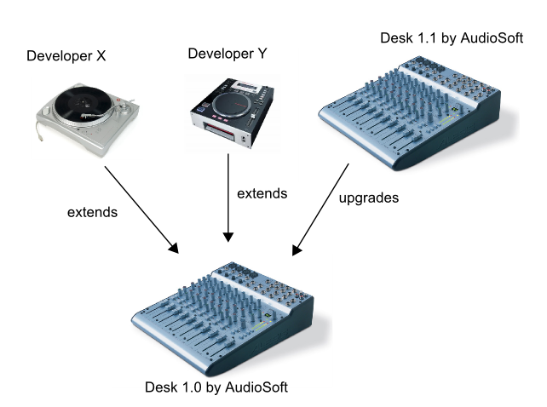

An extension scenario
Radio Station Developers
Developer X
Developer Y
Audiosoft
Notes:
Base versus extensions
Combining extensions
Parties behind software... Mention radio station

Slide 8
5 key requirements
i. ALTER
  Able to make *any* change required
  Unanticipated change!
  Changes proportionate to functionality altered
  At the correct level of abstraction
ii. NO_IMPACT
  Changes shouldn’t impact others if they don’t want them
So, we can’t push just any changes into the “base”...

Slide 9
5 key requirements
iii. NO_SOURCE
  We don’t want to modify (or even see) the source code
  Commercial & complexity reasons
Would extensibility problems go if source was available?
  No...
  Evidence: many open source systems are extensible
Fork a codebase to make a change == owning it?!
  Common TCO issue in industry...
Notes:
E-commerce framework at large investment bank – forked for sales & research each.

Slide 10
5 key requirements... and one extra
iv. COMBINE
  Detect conflict between automatically
  Allow correction of any conflict as a further extension
v. UPGRADE
  Despite changes, we should always be able to upgrade base
  Updated versions of extensions
*. ARCHITECTURE
  System structure should be explicit; capabilities clear
Notes:
I’ve added ARCHITECTURE, although it’s not strictly a requirement for extensibility.

Slide 11

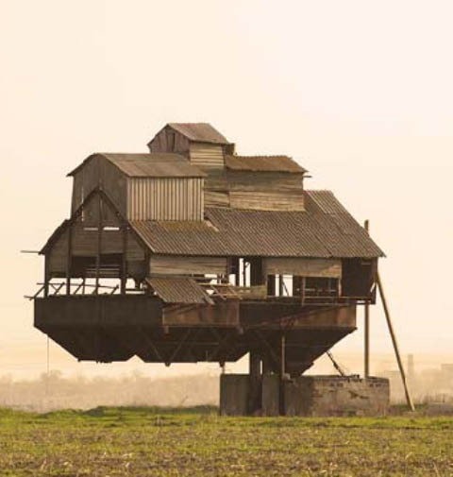
How do we currently
handle extensibility?
Notes:
Existing approaches do not focus on architecture, they are more module-based.

Slide 12




Frameworks & extension points
Build a common framework as base
Extension points are like sockets
Explosion of options
  Over time = union of features
  Sort of works within 1 organisation
  Time pressures lead to forked codebase
Notes:
Mention about frameworks and threads of control, difficult to combine multiple.
Competing demands from 2 different groups will cause conflict = forking.

Slide 13

Plugin architectures
Takes framework approach several steps further
  Everything is a plugin
  Extension points + plugins + registry
  Versioned plugins; plugins for plugins
Deals well with planned change but...
  ALTER restricted
  COMBINE manually checked
  “flat, coarse-grained” architectures
  E.g. WSAD
Notes:
Eclipse, firefox, wordpress, netbeans are prominent examples of this approach.
A plugin is a bit like a module, but usually combined with a component model.
Components inside are “opaque” – architecture not shown.

Slide 14
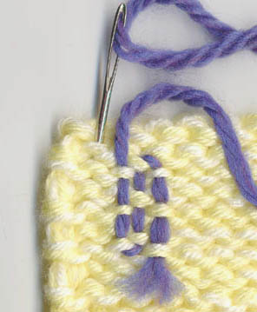
Aspects & weaving
Encapsulate cross-cutting concerns in 1 place
Add & adjust behaviour at various locations in base
Join points are created naturally!
Issues
  Secondary versus primary axis
  Lexical fragility
  ALTER restricted, COMBINE poor
Notes:
Note that hyper/J doesn’t suffer from secondary versus primary.
Also mention product line languages such as AHEAD

Slide 15
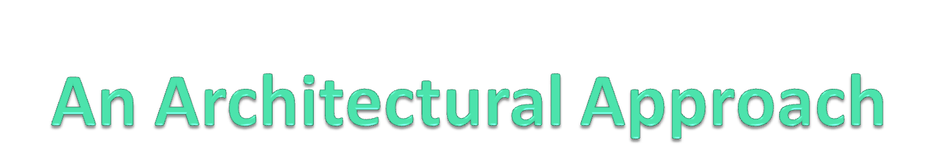


Slide 16
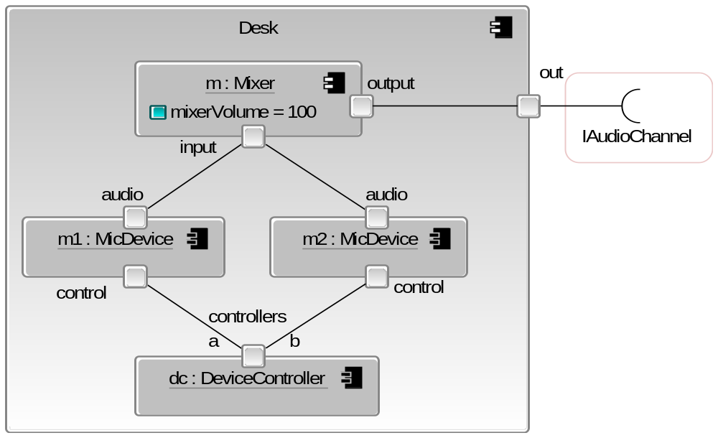
Composing the “base”: audio desk
component Mixer {
attributes:
mixerVolume: int = 100;
ports:
input;
output;
parts:
c: Combiner
set volume (mixerVolume);
e: Equaliser;
connectors:
mixer1 joins out@c to eqIn@e;
mixer2 joins eqOut@e to output;
d delegates-from in@c to input; }
Notes:
Specifically mention Darwin and SOFA
Stress that this is the “base” system.
Explain tie in to Java – each leaf class is a JavaBean! This is a better way of joining beans!
Mention about hierarchy and how mixer is 2 levels deep.
Backbone is a textual language, use UML2 composite structure diagrams for graphical view.

Slide 17
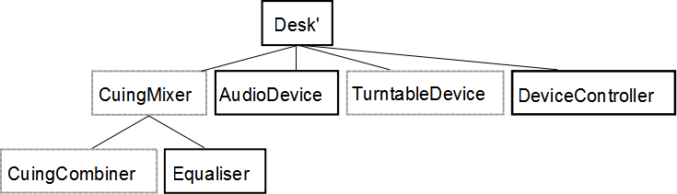
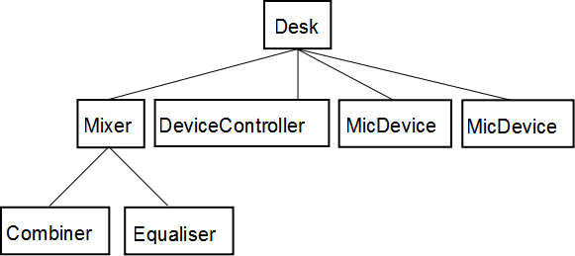
Extending the structure...
We are building layers (and burying abstractions)
Operate on the hierarchical structure via deltas?
How can we add a turntable that requires cueing audio?
Notes:
Mention connectors also.

Slide 18
The key insight
If we could adjust the compositional structure via deltas,
we could make any change *and*
still preserve the original application.
An important question
How do we make this a satisfying design experience?
Base application
Notes:
NOTE: keep deltas separate from base! Apply to get extended system, leave to keep base.
We could carry on doing this – adding deltas on top of deltas
Mention that base is really just add deltas.
Want to have an intuitive way of designing... We will now introduce 3 concepts that unify reuse and extension.

Slide 19
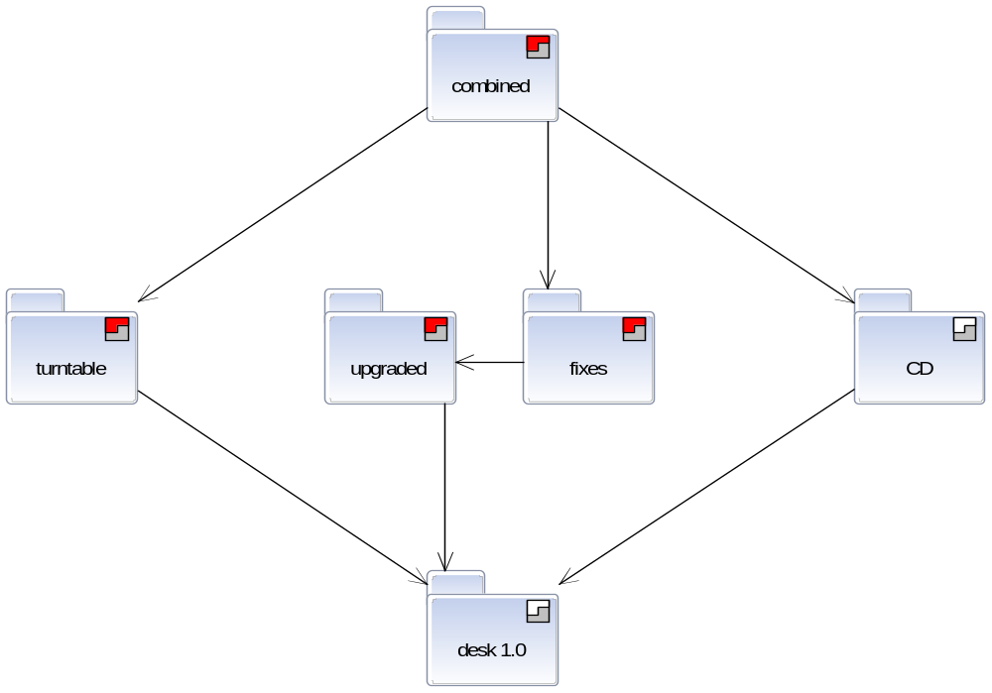
Concept 1: Stratum
A module that holds definitions
Keeps deltas separate from the “base”
R
X
A
R
Y
Ownership of parties reflects extension scenario interplay
A
Notes:
Stratum is a module which is explicit about dependencies on other strata.
Ownership means that others cannot modify it, but can express deltas against it to alter it.
Mention about import / export rules – designed to provide hiding & intent, but allow reaching in if needed.
- Full nesting
- A bit like UML2 packages, but with different nesting rules to suit extensibility better
-- i.e. Children cannot see definitions in parents

Slide 20
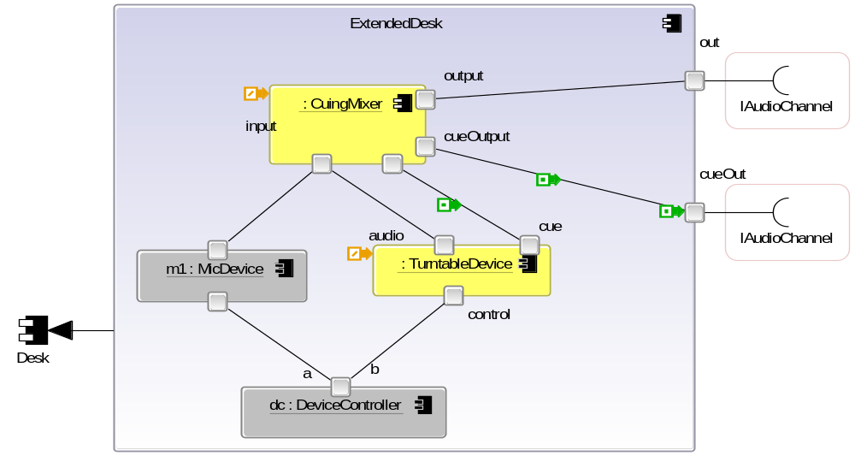
Concept 2: Resemblance
New component as delta changes to another’s structure
  Add / delete / replace ➔ complete remake possible
component ExtendedDesk
resembles Desk
{
ports:
cueOut;
replace-parts:
m becomes cm: CuingMixer;
m2 becomes t: TurntableDevice;
connectors:
cconn joins cueOutput@m to cueOut;
iconn joins cue@m2 to cueInput@m;
}
←
Like an advanced form of structural inheritance... [SGW94]
Notes:
Note that we work with the fully expanded structure at all times.
Creates deltas really... But so does initial creation.
Specifically mention UUIDs -- means this is not lexically fragile.
NOTE: multiple resemblance possible

Slide 21
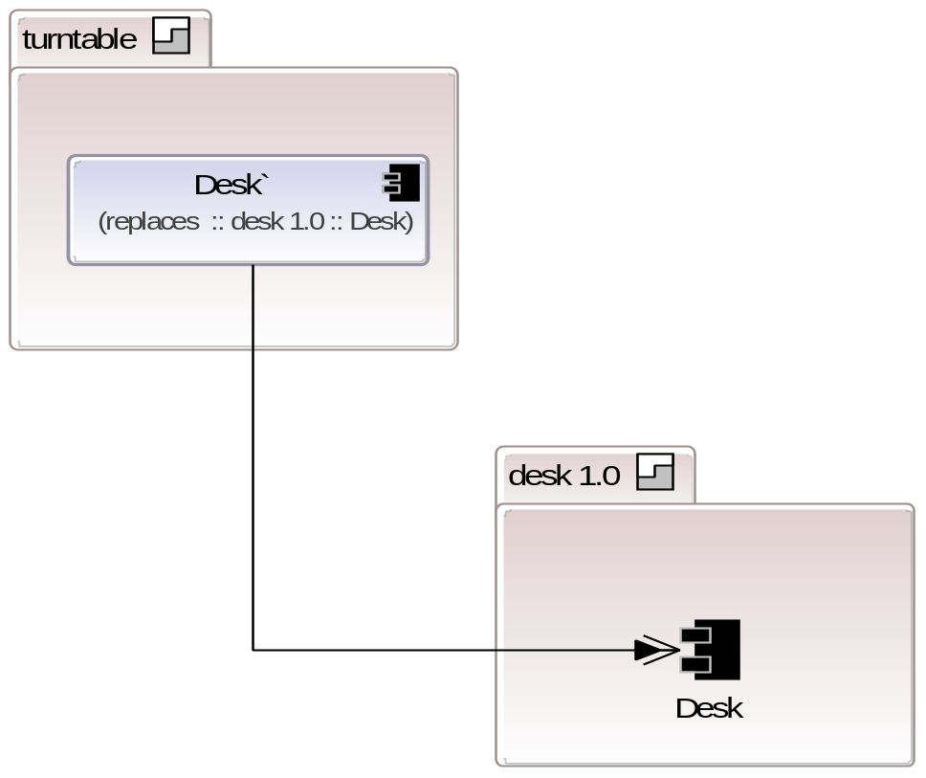
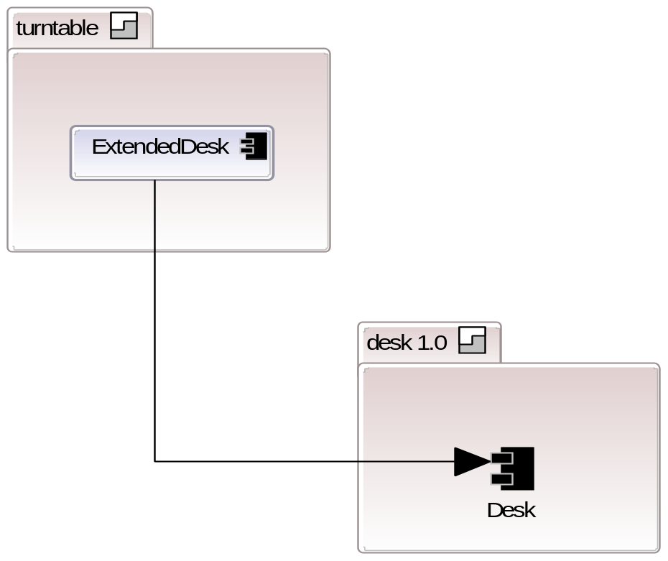
Concept 3: Evolution = resemblance + replacement
Add “replacement” to “resemblance”
  Allows our new incremental definition to supersede the previous one...
component
resembles Desk replaces Desk
{
ports:
cueOut;
replace-parts:
m becomes cm: CuingMixer;
m2 becomes t: TurntableDevice;
connectors:
cconn joins cueOutput@m to cueOut;
iconn joins cue@m2 to cueInput@m;
}
Notes:
Explain how this adds replacement to the existing reuse/resemblance concept... Gives evolutions rather than just reuse.
Mention renaming! – just a human construct...
1 level deep; apply at multiple levels for depth

Slide 22
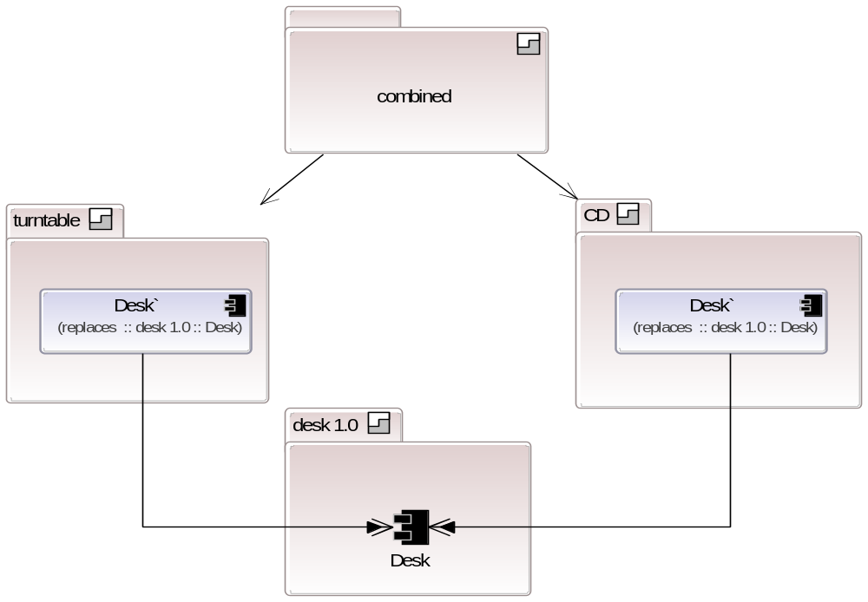
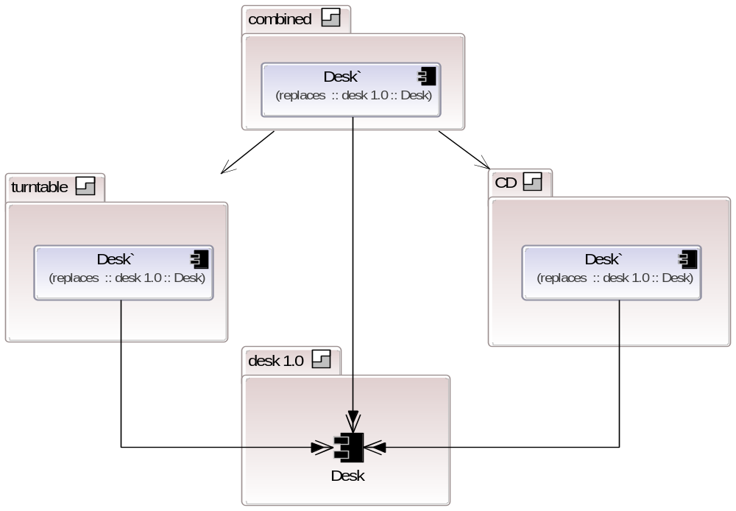
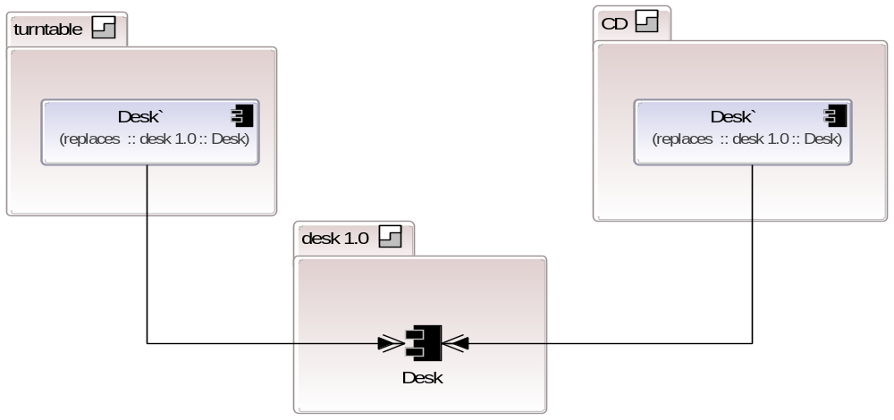
Merging different extensions
Correct using an evolution
Add a CD extension
Merge using another stratum
Notes:
Stratum perspective = what system looks like from each stratum

Slide 23
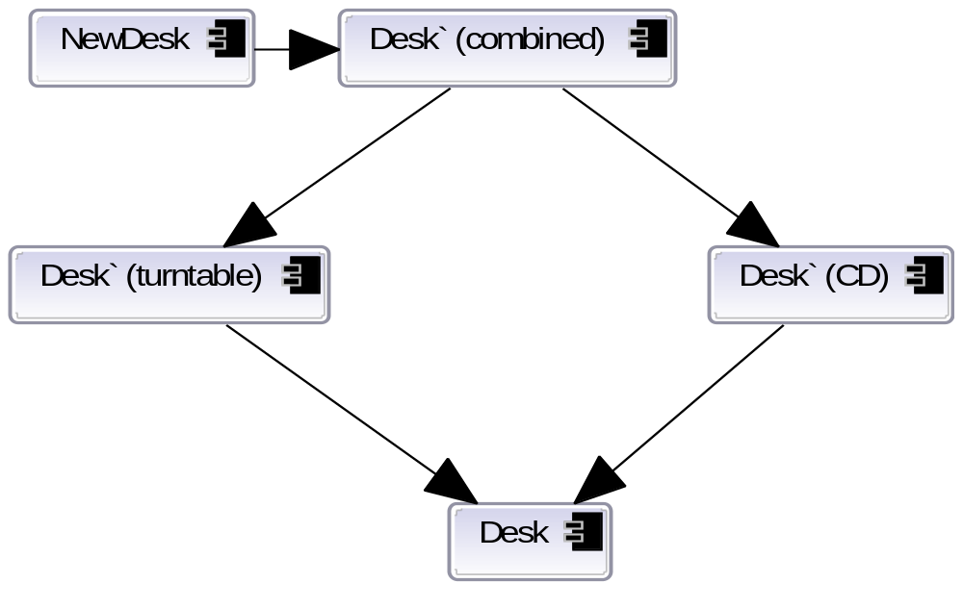
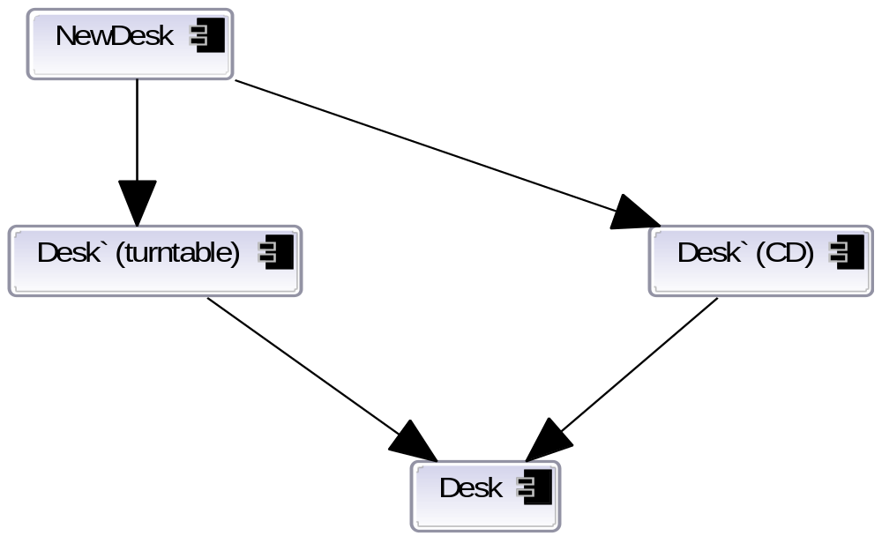
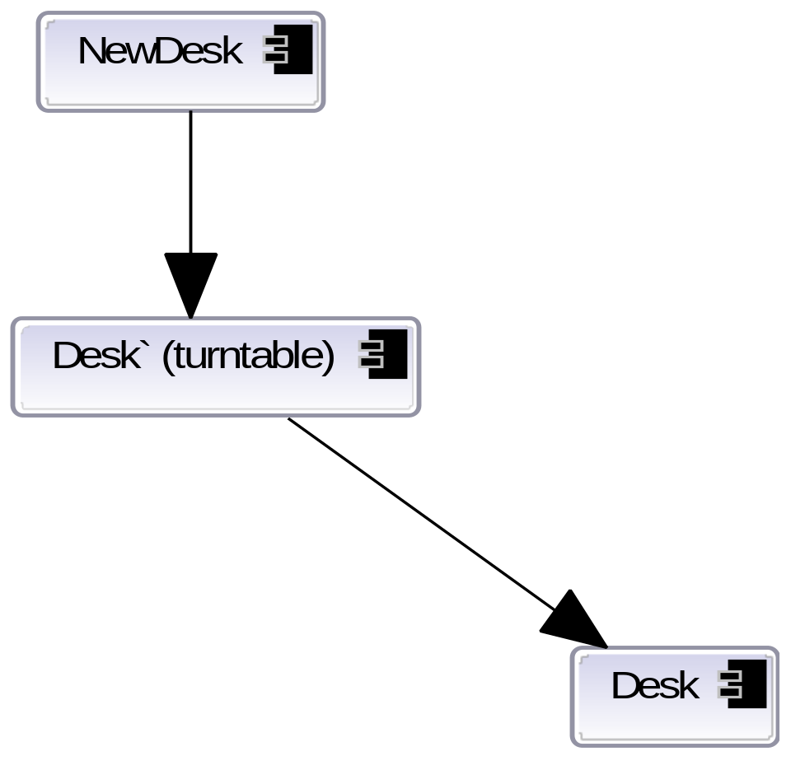
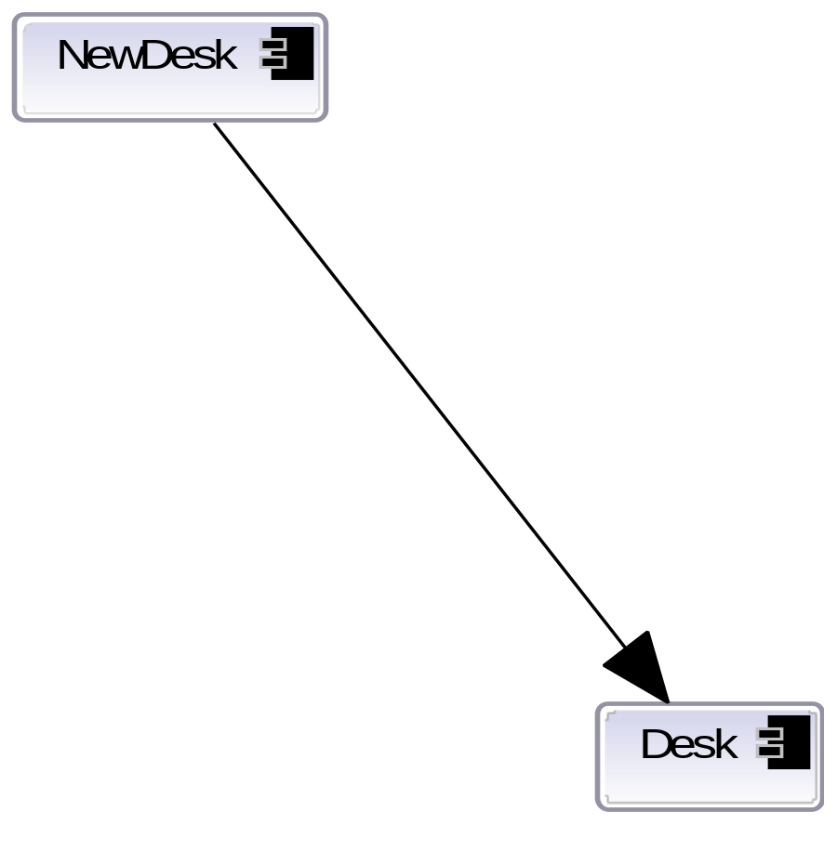
The expanded resemblance graph
Build up for each perspective...
Notes:
Evolution affects resemblance graph for existing elements – i.e. If NewDesk resembled Desk and an extension introduces Desk`, then NewDesk will resemble the evolved desk.
i.e. Ability to affect inheritance of features, and to correct structural errors

Slide 24
Revisiting the extension scenario
Notes:
Each stratum contains definitions, resemblance and evolutions
They work on the system as if they own it, deltas created behind the scenes
Supports combining deltas (like merge)
A bit like branches of a version control system
Structural checks from each “perspective”
Mention notion of a “version”

Slide 25
Checking against requirements...
  ALTER
  NO_IMPACT
  NO_SOURCE
  COMBINE
  UPGRADE
  ARCHITECTURE
Make any structural changes required
Granularity of components determines cost
Automatically creates extension points
Only see changes if extension stratum included!
Combine using dependencies
No source required, only structural description
Deltas allow combining extensions
Combinations checked automatically
UUIDs avoid lexical fragility
Upgrades are also extensions
Check existing extensions with upgrade
Full focus on architecture
Explicit architecture helps extension developers
Notes:
Actual research question:
Can we devise an architectural approach to software that naturally builds extensibility into a system as it is constructed, which also respects the underlying forces and constraints between extension and base application developers?

Slide 26
Aside: why hierarchical components?
Leads to explicit architecture
  Compositional hierarchy = multiple levels of abstraction
  Intuitive electronics “circuit board and chip” metaphor
But, haven’t components “had their day”?
[MDEK95] – Darwin, [PBJ98] – SOFA
No! OO techniques are moving gradually in this direction
  Best practice is composition rather than class inheritance
  Spring/Guice/EJB3 are simple component systems
Notes:
i.e. Why not do it properly?

Slide 27
Summary of Evolve
Architecture / structure is always explicit
  Encodes many best practices
Creation and extension help each other
  Creation does not limit extensibility – creates extension pts
  Extensibility does not compromise further creation
Unifies reuse and evolution concepts at design stage
  Hard to “let go” of designing in extension points
  Slightly “uncanny” feeling – agile architecture!
Evolve is aimed at industry developers!
  http://www.intrinsarc.com
Notes:
NB: can easily be made to work with existing OO environments
Mention about “versioning” and how a version is a (deeply) immutable stratum stamped with something that guarantees this
- discuss how it is perhaps odd we haven’t addressed so far given topic
- version control can be treated orthogonally (2 axes)

Slide 28
Restrictions and Limitations
No semantic or behavioural guarantees after extension
  Future work aimed at behavioural protocols & goals
  [PV02] [MK06]
  Extensions will be able to alter these descriptions
Cost of change not always proportional to desired change
  Granularity of components
Alien approach to many industry developers
  Moving beyond a textual description!
  Teach composition first?
Notes:
Mention sequence diagram protocols, translated into LTS
Mention retrofitting approach onto LTSA
Finally, contention is that structure should be graphical and separated from code
Challenges: difficult to educate developers; why handle the learning complexity? How to make it compelling? Not a complexity thing – consider how much complexity J2EE/EJB developers have coped with... Is it a hype thing?

Slide 29
Bibliography
[KF98]- Toward a Formal Theory of Extensible Software
  Shriram Krishnamurthi, Matthias Felleisen, SIGSOFT '98/FSE-6
[Par78] - Designing Software for Ease of Extension and Contraction
  David Parnas, ICSE ’78
[BBHL04] - Software Evolution
  Keith Bennett, David Budgen, Tony Hoare, Paul Layzell
  Grand Challenges for Computing, 2004
[Ben03] - The software maintenance of large software systems: Management, methods and tools
  Keith Bennett, Reliability, Engineering and System Safety 1991
[SGW94] – Real-Time Object Oriented Modeling
  B. Selic, G.Gullekson, P. Ward, John Wiley & Sons, 1994
[MDEK95] - Specifying Distributed Software Architectures
  Jeff Magee, Naranker Dulay, Susan Eisenbach, Jeff Kramer, ESEC 1995
[PBJ98] - SOFA/DCUP: Architecture for Component Trading and Dynamic Updating
  Plasil F., Balek, D., Janecek, R., ICCDS 1995
[PV02] - Behavior Protocols for Software Components
  Plasil, F. and Visnovsky, S., IEEE Transactions on Software Engineering 2002
[MK06] - Concurrency (State Models and Java Programs)
  Magee, J. and Kramer, J., John Wiley and Sons Ltd 2006

